Slide 1
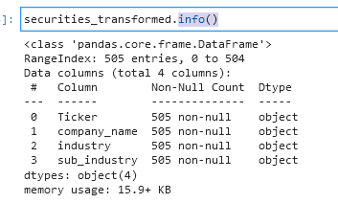
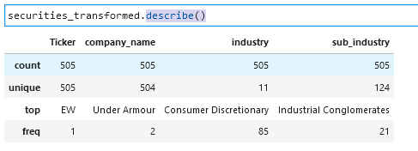
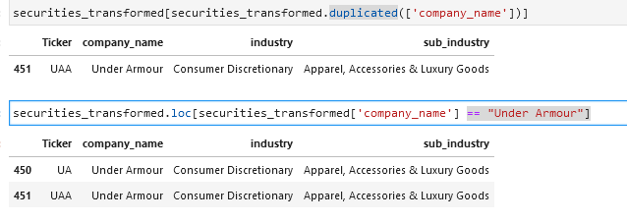
Transform Details for Securities
Following data transforming steps are performed using Securities:
Check if the data is not null – Pandas use info() method and describe() methods to check for null and duplicates
Review duplicate company name to check for bad data – Pandas duplicated() to find duplicate company_name. Then select rows targeting company_name == “Under Armour”. Review other tables to determine if there is an error

